Slide 1
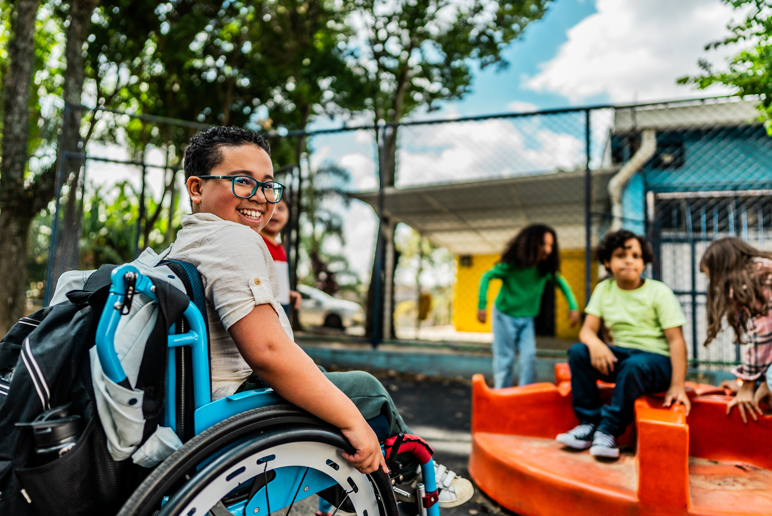
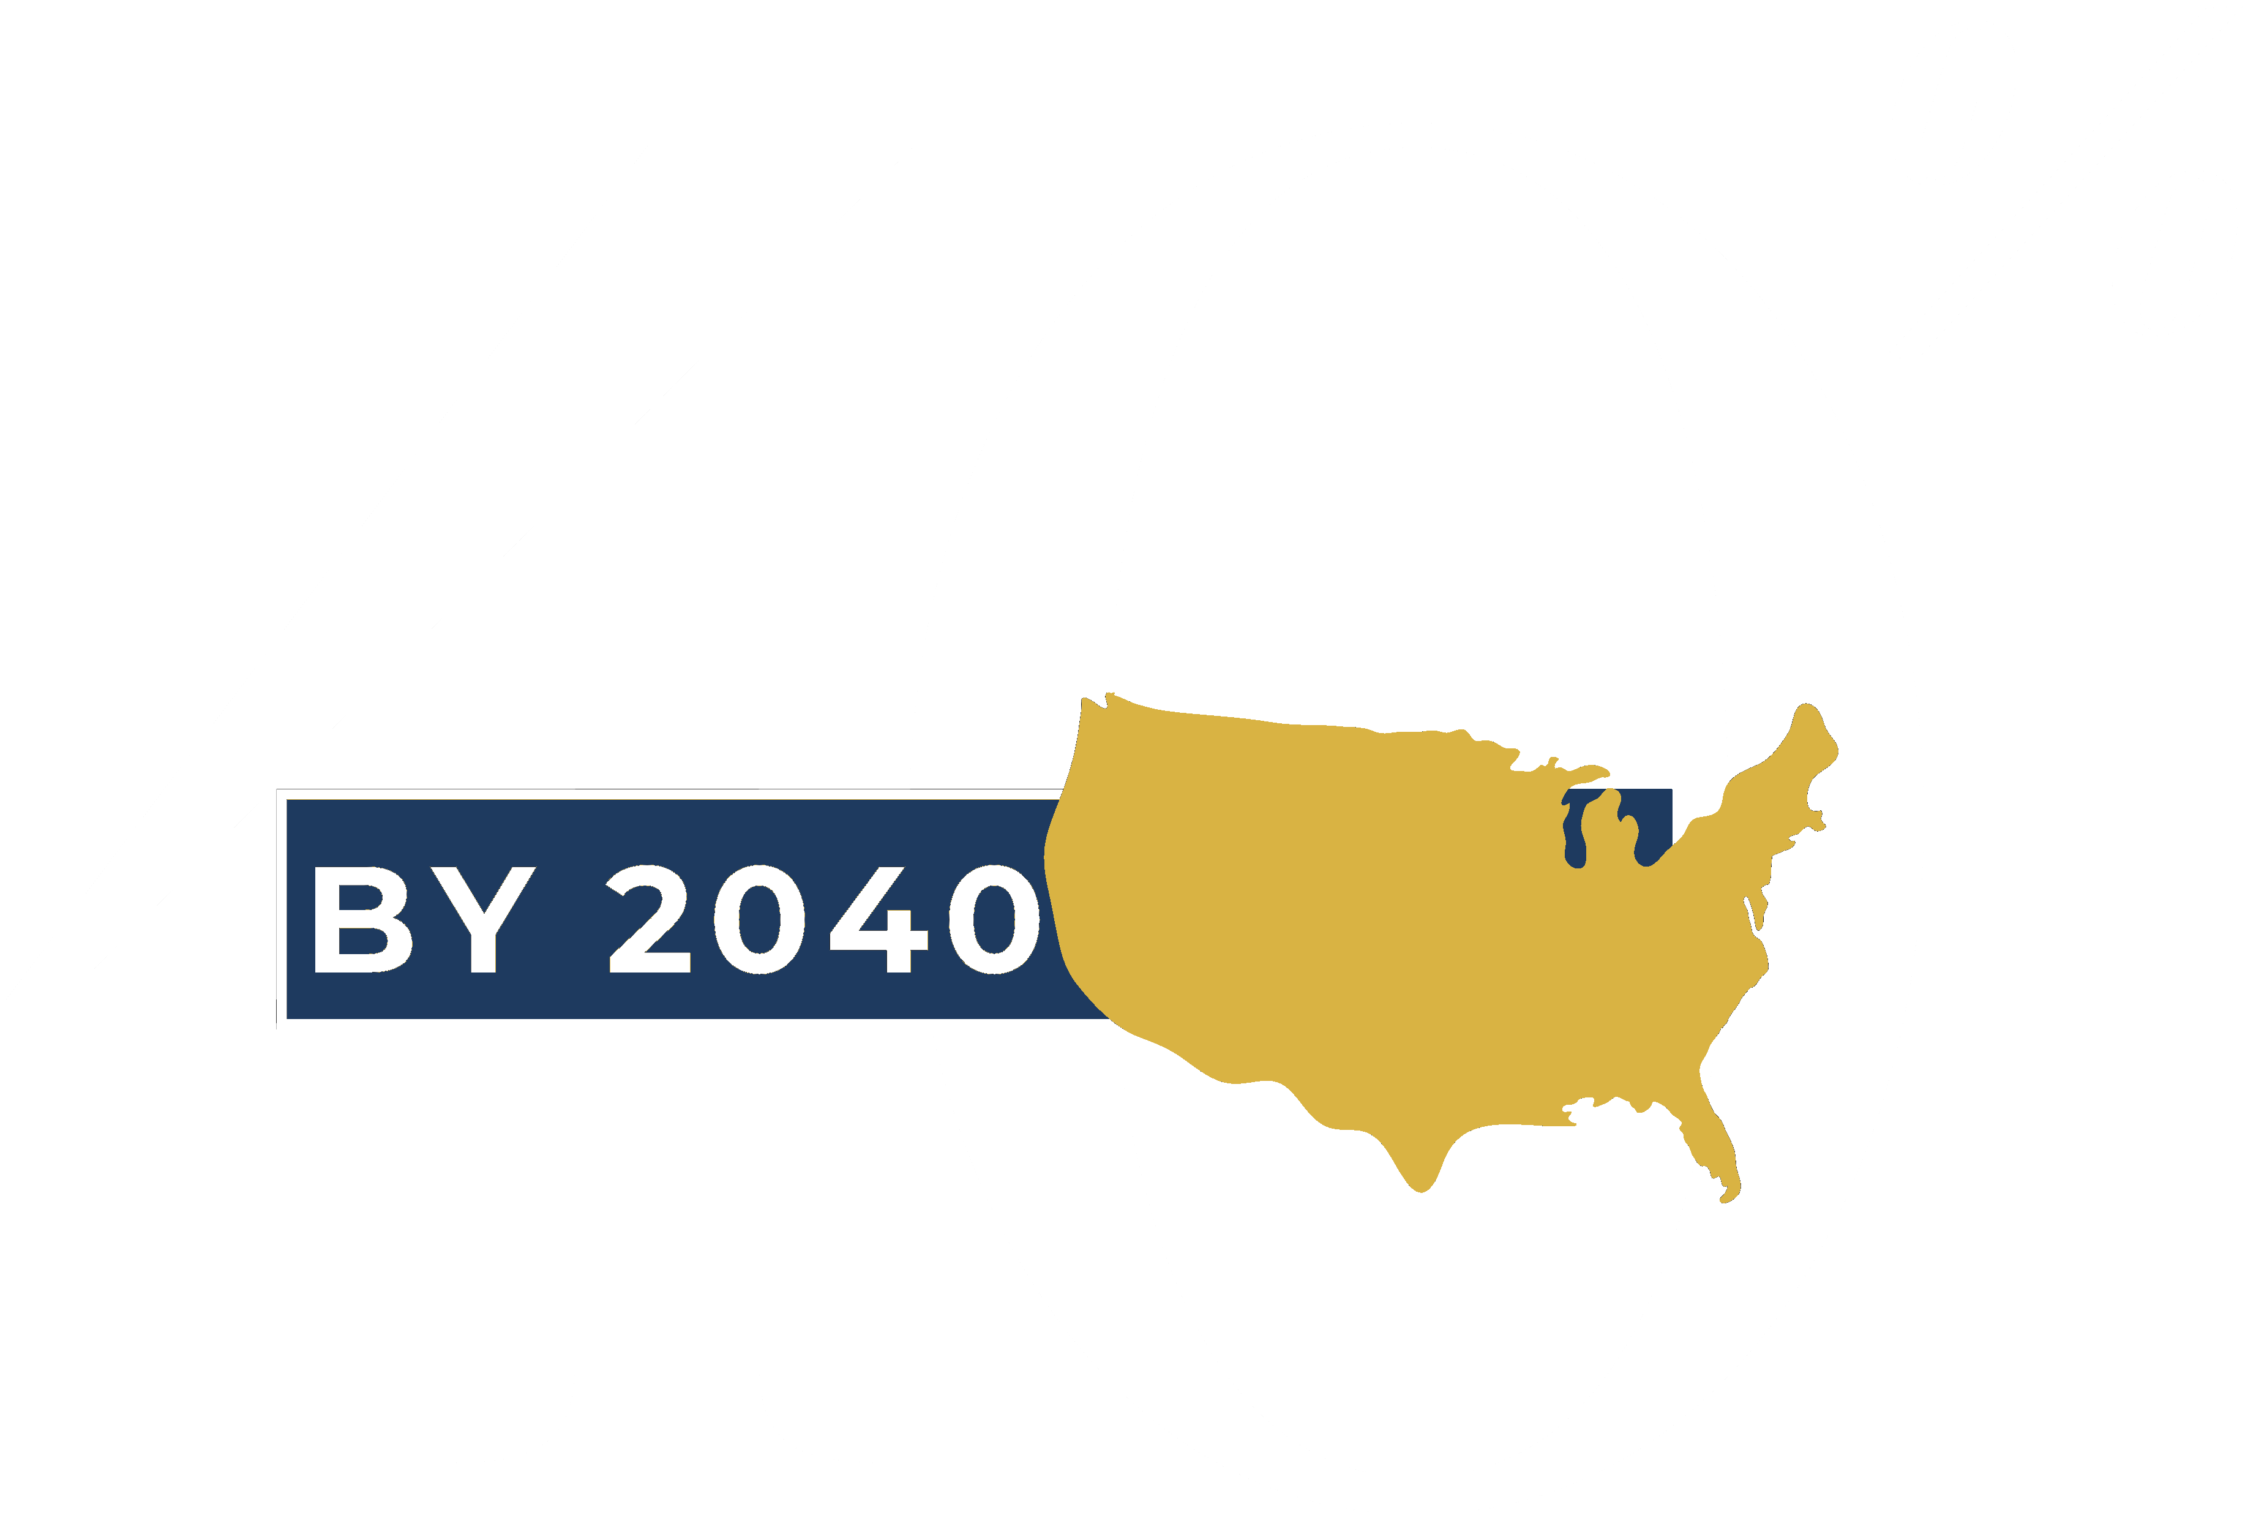
40 by 40
Fulfill the IDEA Promise
A national coalition of state school boards associations fulfilling Congress's 50-year-old funding promise.
Illinois Association of School Boards | October 2026

Slide 2
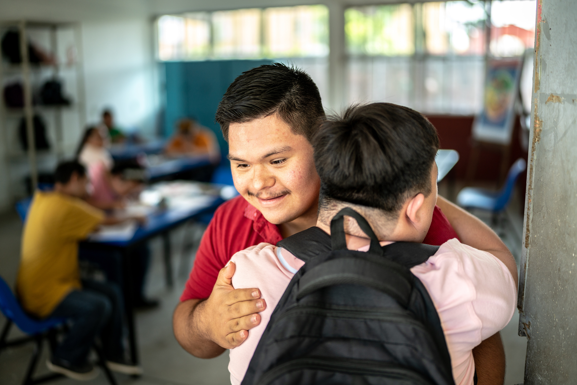
THE COALITION
Built by State School Boards
Associations, for School Boards
40
States and counting
National Partners: Consortium of State School Boards Associations (COSSBA), National School Boards Association (NSBA), the National Rural Education Association (NREA); the IDEA Full Funding Coalition
Illinois State Partners: Illinois Association of School Boards (IASB); Illinois Association of School Administrators (IASA); Illinois Principals Association (IPA), Illinois Association of School Business Officials (IASBO); Association of Illinois Rural and Small Schools (AIRSS)
Why a coalition: 40 states speaking together carries more weight in Congress than one district speaking alone.
40 by 40: Fulfill the IDEA Promise
6

Slide 3
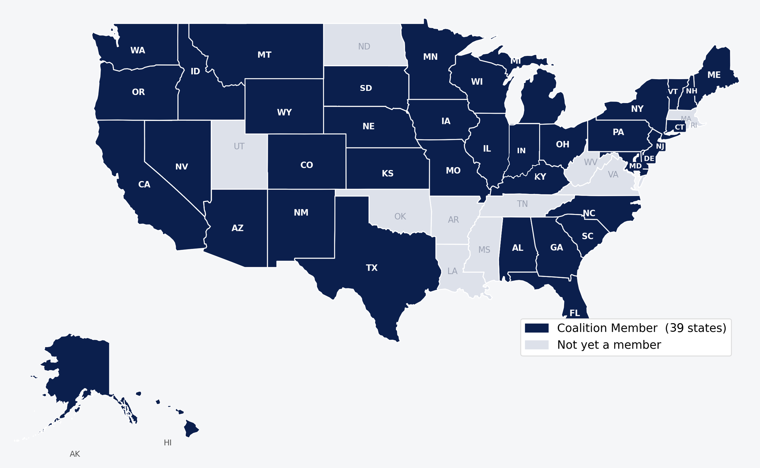
THE COALITION
40 states committed
40 States and Growing
North Dakota joined 10/2026
40 by 40: Fulfill the IDEA Promise
7

Slide 4
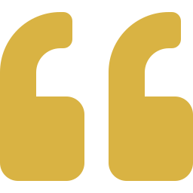
THE BACKGROUND
A Promise Made in 1975
“We will have to put our money where our mouth is.”
STUDENTS SERVED UNDER IDEA
3.7M
— Sen. Harrison Williams, on introducing IDEA, 1972
in 1976-77,
the first year
In 1975, Congress passed IDEA, guaranteeing every student with a disability a free, appropriate education.
Congress committed to fund 40 percent of the cost of that mandate.
8.3M
projected in 2027 —
more than double
Source: U.S. Dept. of Education; FY2027 Budget Request
40 by 40: Fulfill the IDEA Promise
2

Slide 5
THE GAP TODAY
Fifty Years Later, the Promise Remains Unmet
PROMISED IN 1975
ACTUAL FEDERAL SHARE TODAY
40%
10%
of the cost of special education
leaving districts to cover what Washington doesn’t
That 30-point gap is covered by state and local dollars.
40 by 40: Fulfill the IDEA Promise
3

Slide 6
THE TREND LINE
Federal IDEA Funding Share, 1981–2025
40% promised
THE PATTERN
Peaked near 19% in the mid-2000s.
Never reached the 40% promise.
Still a 25+ point gap today.
Source: Congressional Research Service, Report R44624
40 by 40: Fulfill the IDEA Promise
4

Slide 7
YOUR ROLE
How School Boards Can Engage
1
September - October
2
November - February
3
February - April
Learn the Facts about IDEA in Your District
Adopt the 40 by 40
Resolution of Support
Contact your Member
of Congress
What percent of special needs services is covered by federal funding in your district?
Educate your school community and activate their support.
Ask your Representative and Senators to champion the annual IDEA increases.
Start the conversation with your school board today!
Students with disabilities cannot wait another 50 years.
Let’s finish the job Congress started in 1975.

Slide 8




THE ASK
What We're Asking Congress to Do
1
2
3
Enact a Multi-Year Glide Path
Protect IDEA From Cuts
Reaffirm the Commitment
Increase IDEA funding annually to reach 40 percent.
Shield special education from across-the-board cuts.
Recommit to students with disabilities and their schools.
This is not a partisan issue. Fully funding IDEA is a bipartisan, multi-generational promise that every Congress has fallen short.
40 by 40: Fulfill the IDEA Promise
13

Slide 9



STRATEGIC FRAMEWORK
What the Campaign Is Built to Achieve
Secure Bipartisan Support
Raise Public Awareness
Bring State-Specific Data
Generate Real Momentum
Congressional backing for a path to 40 percent
Show how underfunding burdens districts
Equip offices with local numbers and stories
Drive attention that's hard to ignore
TARGET AUDIENCES
Influencers: associations, board members, superintendents, parents
Recipients: congressional delegations, appropriators, media, public
40 by 40: Fulfill the IDEA Promise
7

Slide 10
HIGH-LEVEL LAUNCH PLAN
A Phased Rollout, Built Around the Congressional Calendar
Grassroots work begins in September. Congressional advocacy runs continuously from November through April.
SEPT
OCT
NOV
DEC
JAN
FEB
MAR
APR
GRASSROOTS
Inform districts;
Local action: resolutions,
Weeks of
launch materials and website
op-eds, testimonials
Action
CONGRESSIONAL
ADVOCACY
Meetings · Testimony · Leave-Behinds
Continuous engagement through the appropriations calendar
PUBLIC &
DIGITAL
Broad public action: website live, op-eds, social push
Advocacy doesn't wait for one moment — it runs from the first post-election meetings in November through the spring appropriations push in April, spanning the new Congress convening in January.
40 by 40: Fulfill the IDEA Promise
8

Slide 11


MESSAGING FRAMEWORK
One Message, Told Consistently Nationwide
“Congress promised 40 percent in 1975. Today it's 10 percent — and districts pay the difference. Congress must fulfill its promise.”
Consequences
The Solution
The Call to Action
Cuts investment in all students
Hits rural districts hardest
Pressures local levies
Deliver 40% federal funding
A realistic, multi-year path
Fiscally responsible, overdue
Honor the IDEA commitment
Fund 40 percent
Don't wait 50 more years
40 by 40: Fulfill the IDEA Promise
10

Slide 12
Thank You
Let's finish the job Congress started in 1975.
Illinois Association of School Boards
www.40by2040.org
40 by 40: Fulfill the IDEA Promise
15

