Slide 1
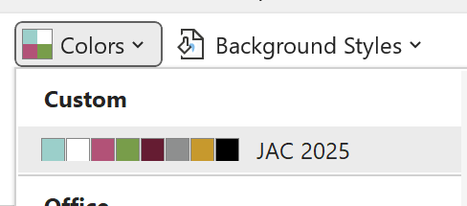

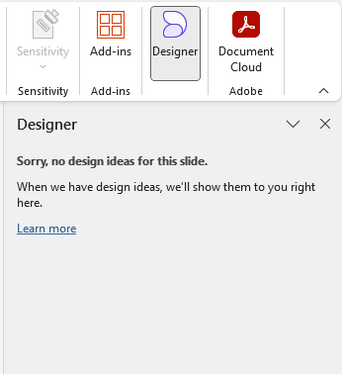






IASB PowerPoint Tips
Do use Arial font.
(This is IASB’s preferred font for presentations because, as a standard Microsoft font,
it reduces the likelihood of font substitutions.)
Do use JAC brand colors, which are built into this template’s theme.
Do use PowerPoint’s Designer (optional).
If you plan to share your presentation file or PDF with members, (posting online or sending via email), it is best practice to make it ADA-compliant:
  Do add Alternate Text to images. (Right click on image + View Alt Text or click under the Accessibility tab).
  Do mark decorative-only images (images that add visual but are not informative).
  (Right click on image + View Alt Text and then check “Mark as decorative” box or click under the Accessibility tab.)
  Do use PowerPoint’s built-in Accessibility Checker (under the Accessibility tab OR in bottom right corner).
  Don’t use “Smart Art.” It is not ADA-compliant.

Slide 17








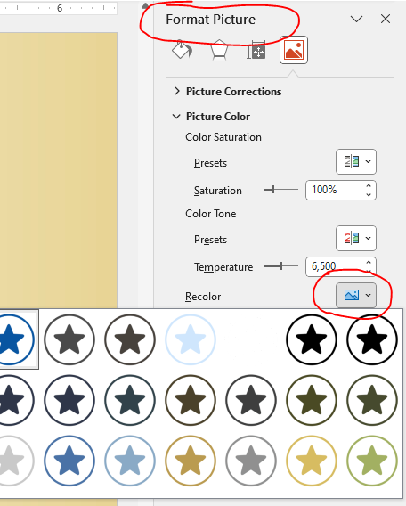






ICON LIBRARY
Copy and paste icons from this slide as needed. For example, substitute bullet characters with icons, use icons to highlight an important point. You might use the icon to indicate a link to a video. To change the icon color, go to “Format Picture.”

Slide 18
This is a Mockup
Please see slide 9
Text Here
Mockup
Bullets

Slide 19

This is a mockup
TITLES
See slide 11

Slide 20
This is a mockup
TITLES
SEE SLIDE 13

Slide 21
This is a mockup
See slide 12

Slide 22
This is a mockup
TITLES
See slide 13 – There is an added icon and description below.
Note: Example use of item and text for mockup only.

