Slide 1

How to Navigate
Running for School Board
Understanding the
Board Member's Role
December 8, 2022
noon

Slide 2
Presenters:
Reatha Owen Director of Field Services, IASB;
rowen@iasb.com;
(217)528-9688, x1124
Laura Martinez Director of Field Services, IASB;
lmartinez@iasb.com;
(608)629-3776, x1245

Slide 3
Speaker:
Stephen Nelson, Board Vice President,
Sycamore CUSD 427

Slide 4
All You Need to Know About Being a New Board Member
More of What You Need to Know About Being a New Board Member

Slide 5
Overview
The Big Picture
  Illinois Association of School Boards
  Public Education in Illinois
Governance Basics
Mandatory Board Member Training
Veteran Board Member Share His Perspectives
Q & A

Slide 6
IASB Mission Statement
The mission of the Illinois Association of School Boards is to Light the Way for its members by developing their competence and confidence through a robust toolkit designed to build excellence in local school board governance, including:
  Premier training experiences;
  Networking opportunities for mutual support;
  Valuable benefits, pooled services, information, and expertise;
  Advocacy on behalf of public education; and
  A platform for a strong collective voice on common interests and concerns.

Slide 7
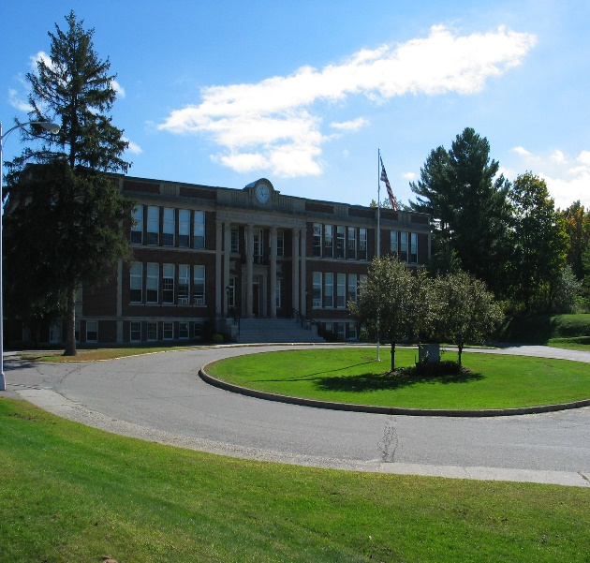
Districts in Illinois 2019-2020
Elementary | 368
High School | 96
Unit Districts | 388
Total | 852
3,849 Schools
Source: FY21 ISBE Annual Report, page 21

Slide 8
District Size – Student Enrollment
2020-2021
Smallest | 27 | (Ohio CHSD 505)
Largest | 35,870 | (Elgin U-46)
Chicago | 331,263
Source: 2021-22 Fall Enrollment Counts

Slide 9
IL Public School Enrollment
2020-2021
Pre-Kindergarten through Grade 12
1,887,316 students
(91.4% of all Illinois school students)
Source: FY21 ISBE Annual Report, page 26

Slide 10
Racial/Ethnic Diversity
Source: FY 21 ISBE Annual Report, page 28

Slide 11
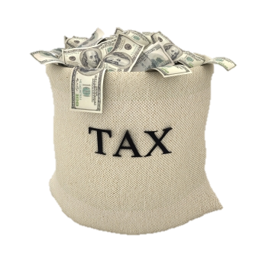
Revenue and Expenditures Education in IL (2020-2021)
Revenue Sources
Local 43.5%
State 31.9%
Federal 24.7%
Expenditures
More than $33 billion
Source: FY 21 ISBE Annual Report, pages 6 and 13

Slide 12
Operating Expenditure/Pupil
(FY2021)
District Type | Median Expenditure | Expenditure Range
Elementary | $14,119 | $6,503 - $38,918
High School | $16,922 | $10,537 - $39,033
Unit | $12,287 | $8,474 - $26,975
Source: Operating Expense Per Pupil (OEPP) data

Slide 13
Education in the U.S:
A Large, Complex System
49.5 million public school students (fall 2021)
4.7 million private school students (2019-2020 school year)
98,469 public schools (2019-2020 school year)
2 million public school teachers (2020-2021 school year)
500,000 private school teachers (2020-2021 school year)
13,452 public school districts (2018-19 school year)
Over 90,000 board members
Source: National Center for Education Statistics

Slide 14
Board Demographics
Newly elected in 2021 | 1,125 (19%)
Board members between the age of 18 - 29 | 0.4%
Board members between the age of 30 - 39 | 7.6%
Board members between the age of 40 – 59 | 58.8%
Board members over the age of 60 | 33.1%
Source: IASB Member Survey and IASB database

Slide 15
Foundational Principles of
Effective Governance
The Board
Clarifies District Purpose
Connects with the Community
Employs the Superintendent
Delegates Authority
Monitors Performance
Takes Responsibility for Itself

Slide 16
Board Expectations
Synergy
  The whole is greater than the sum of its parts.
  Requires trust: good communications, quality data, and agreement on a clear purpose.
  Practice a shared discipline.
  Accountable to the district and children – present and future.
Whole board governs, not one individual board member

Slide 17
Board Expectations
Members sit around the table as equals.
Listen to each other, share information freely.
Contribution of each member important.
Accept responsibility for group decisions and board behavior.

Slide 18

New Board Members
Chart Your Course: New Board Member Training Bundle
This online training bundle sets you on the road to success and includes three courses.
Open Meetings Act (OMA)
Professional Development Leadership Training (PDLT) and Performance Evaluation Reform Act (PERA) Training for School Board Members
The Basics of Governance
  www.iasb.com

Slide 19
Mandatory Training
Open Meetings Act Training
Must complete no later than 90 days after taking the oath of office.
Focuses on the law as it pertains to school board meetings and members.
  www.iasb.com

Slide 20
Mandatory Training
Professional Development Leadership Training (PDLT) and Performance Evaluation Reform Act (PERA) training
Must complete the training within the first year of the board member’s term
4 hours of training including:
    Education and labor law
    Financial oversight and accountability
    Fiduciary responsibilities
    PERA training-for board members who will participate in a vote on a dismissal based upon the Optional Alternative Evaluation Dismissal Process
    www.iasb.com

Slide 21
Board Member Training
The Basics of Governance
Get up to speed with this essential course on board and board member roles and responsibilities in creating an effective governance team.
  www.iasb.com

Slide 22
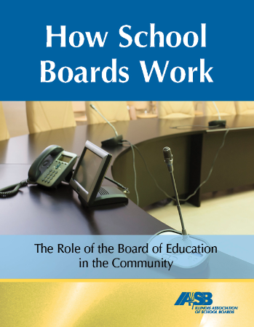

Slide 23


Slide 24
Board Member Sharing
  Stephen Nelson
  Board Vice President
  Sycamore CUSD 427

